Slide 1
Module 11.2 Presentation on the Outland Adventures Case Study
Created by Group 4:
Christopher Reaney, Noel Miranda, Kevin Ramirez, Korbyn Mock

Slide 2
Case Study Summary
Blythe Timmerson and Jim Ford, two outdoor enthusiasts, founded Outland Adventures. The business was originally intended to be a ‘side’ to go along with their primary careers.
They have a few employees to act as guides, another for marketing, one for supplies, and another that developed an online shop.
The owners are working to find a means to organize their inventory so that they can ensure sales are maintained.
Some items may have been hanging around the shop for a while, and there is likely some room to ensure that trip bookings don’t start to dwindle.

Slide 3
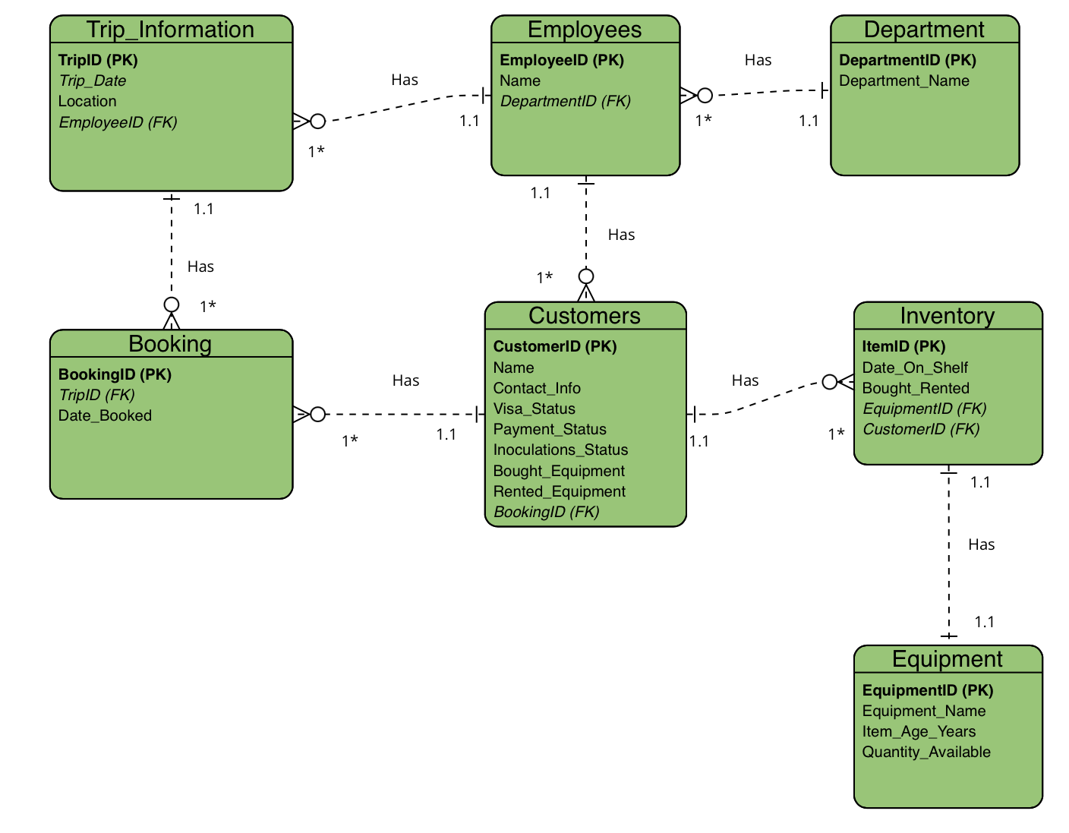
Finalized ERD

Slide 4
Report One Details
Business Problem:
Do enough customers buy equipment to keep sales steady?
Solution Overview:
This python script will help to retrieve the total number of distinct customers, the total number of equipment bought (including customers who bought equipment multiple times throughout different bookings), and the total number of equipment rented (including customers who rented equipment multiple times throughout different bookings) which all this data is per specified year decided by the user. The data that is retrieved from the database will be integer numbers which can then be put into a graph to make a more visually appealing analysis. Since the data in the database for Outland Adventures currently holds bookings only for the year 2024, the data is limited to be analyzed only for that year. The current data in the database is still enough to see if enough customers are buying equipment to keep sales steady. If you were to input any other year after 2024, the data for each category will be zeroes because we are still not in the year 2025, thus there are no bookings yet for that year. Once bookings are made for the incoming years and they are inputted to the database, this script will be able to retrieve that information efficiently.
After running the script with our current database, we can see that around 33% of the total customers that booked for the year 2024 bought equipment. On the other hand, we can see that 66% of the customers that booked rented out equipment. Based on this information, the owners can decide their threshold on when to pull the plug on continuing to sell their equipment because the customers are not buying enough to keep sales steady. I would say anything less than 50% is not good for the business, therefore I would probably put a high emphasis on just renting equipment since it is making the most profit or I can decide to enhance my advertising for selling my equipment to improve such numbers. The owners have many possibilities of deciding what to do with this information. Although, it is important to emphasize that the python script allows for input from the user to analyze the year they desire, therefore before going public with this database, the owners should know that the input does not have validation. It is up to the discretion of the owners if they would like us to provide validation to the input feature if they want to avoid security breaches or restrict incorrect inputs once the database becomes public.

Slide 5
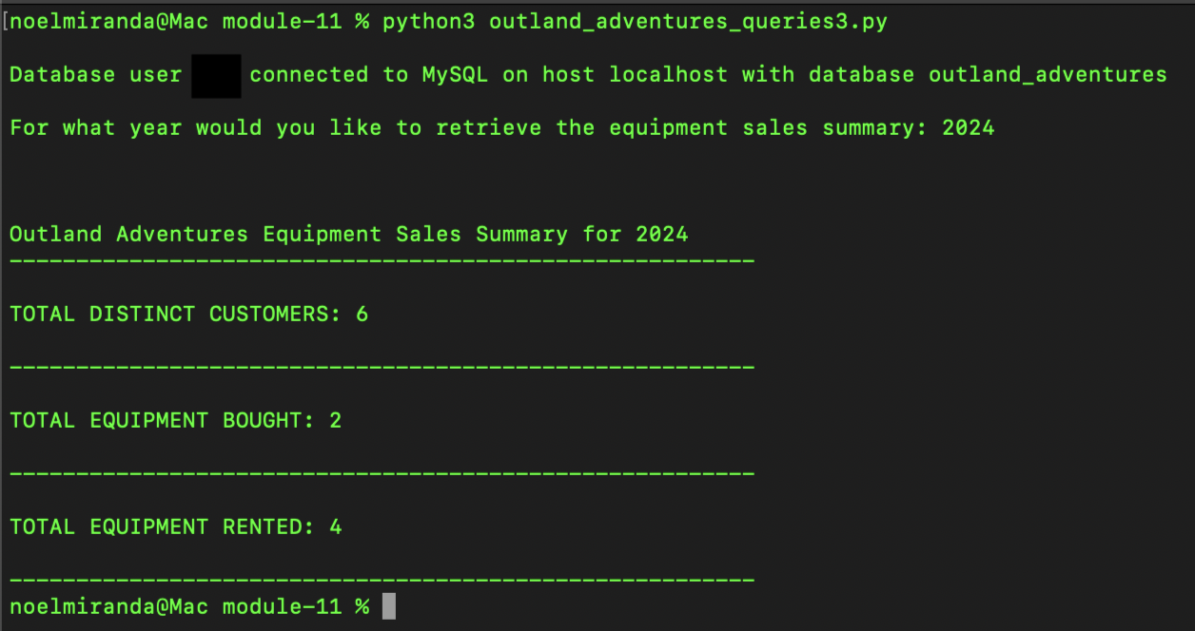
Script Output Image
Report 1

Slide 6
Report One Assumptions
Assumptions:
The owners want a report to analyze yearly equipment sales made by customers.
The owners also wanted to analyze the equipment rented by customers yearly.
The owners want a stored procedure with their database to make this type of report.
The owners would like to input the year for their analysis of the equipment bought.
The owners want the report to display zero sales if there are zero sales for that year.
The database would be private.
The owners do not want a validation to the input feature since this will be a private database.
The owners want to keep track of distinct customers instead of tracking the same customers multiple times.
The owners want to keep track of the equipment sold or rented even if it is by the same customer at a later time (a different booking).

Slide 7
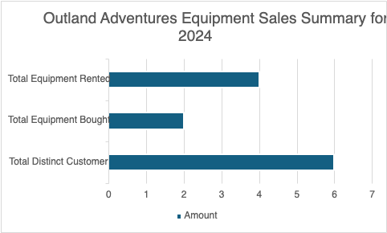
Report 1 Data Chart
This graph aims to illustrate the equipment sales summary for categories such as equipment rented, equipment bought, and the number of distinct customers in the 2024 calendar year.

Slide 8
Report Two Details
Business Problem:
Is there a specific location (like treks in Africa, Asia, or Southern Europe) where bookings are trending down?
Solution Overview:
The constructed python script for this business problem will help to retrieve the number of bookings per specified year and grouped per location (specifically continents) which are part of Outland Adventures’ operations. The data that is retrieved from the database will be numbers which can then be put into a graph to make a more visually appealing analysis. Since the data in the database for Outland Adventures currently holds bookings only for the year 2024, the data is limited to be analyzed only for that year which is still helpful to see what locations are trending up or down.
After running the script, one can see that the Southern Europe location for the year 2024 is trending down since there are no bookings compared to the other available locations. After Outland Adventures fills the database with more bookings throughout the years, then they could be able to analyze across different years and see which locations should be removed from their business and which are gaining attraction. The python script allows for input from the user to analyze the year they desire. However, it is important to emphasize that the input does not have validation, therefore it is up to the discretion of the owners if they would like us to provide validation to the input feature if they want to avoid security breaches or restrict incorrect inputs once the database becomes public.

Slide 9
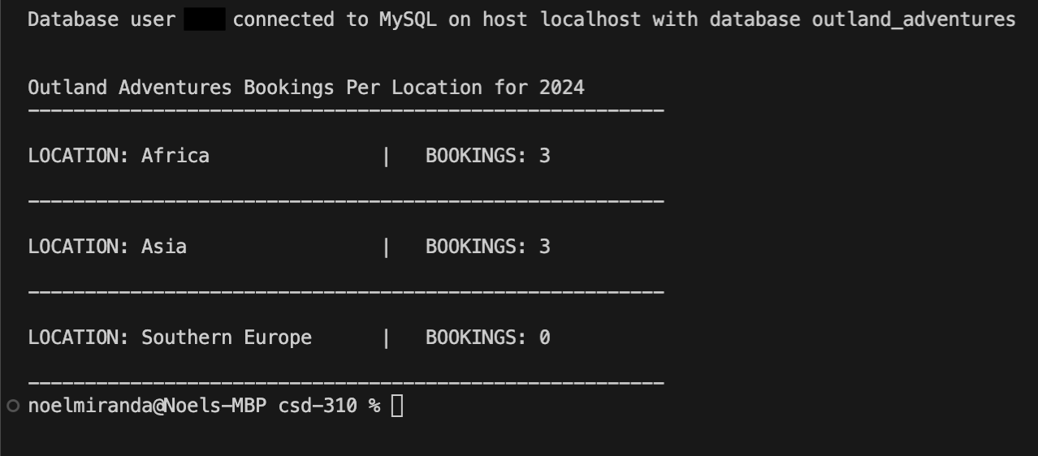
Script Output Image
Report 2

Slide 10
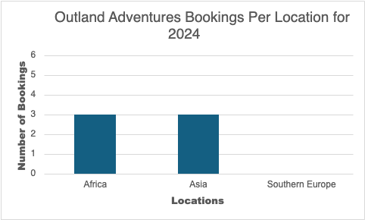
Report 2 Data Chart
The graph depicts the number of bookings made by customers for locations that are part of Outland Adventures’ operations. This graph covers data from the 2024 calendar year.

Slide 11
Report Two Assumptions
Assumptions:
The owners want a report to analyze yearly trends.
The owners want a report to analyze the bookings per continent locations.
The owners want a stored procedure with their database to make the reports.
The owners would like to input the year of analyzing bookings, therefore the stored procedure allows an input of the year.
The owners want the report to display zero bookings if there are zero bookings.
The database would be private.
The owners do not want a validation to the input feature since this will be a private database.

Slide 12
Report Three Details
Business Challenge
Are there any items in the inventory that have been stored for over five years?
Business Value:
The information provided by running the Python script detailed on the next page will help managers and employees make informed decisions on inventory lifecycles. Over time, equipment wear and tear will cause problems and replacing them will reduce costs; it comes down to an efficiency vs. maintenance trade-off. Oftentimes, improper tracking of maintenance or equipment replacement will cause downtime for a business, causing underperformance in revenue. This script aims to combat this issue by supplying data on equipment subject to replacement. It will also aim to keep inventory turnover at a healthy pace.

Slide 13
Report Three Solution Details
Objective of Script:
The objective of this script is to analyze the SQL database and identify the equipment and inventory Outland Adventure has had on the shelf for more than 5 years. The current script will retrieve the information from item with their matching identifiers and print the results. This script ensures that equipment and inventory within the business is up to industry standards, and it will ensure the safety of the customers that buy or rent items from Outland Adventure.
Description:
The report is generated by querying the SQL Database (Outland_Adventures) for the inventory based on the data table “Inventory”. This information will be relative to the current date and for the sake of comparison some data may be subject to change to output proper results. Each item in the table is analyzed for its age and will display the following information:
Item ID: The identification number to be able to distinguish the exact number of each item
Date_On_Shelf: The date the item was placed in inventory
Equipment_Name: The name of the type of item stored
Age: The current age of the item printed in years and days

Slide 14
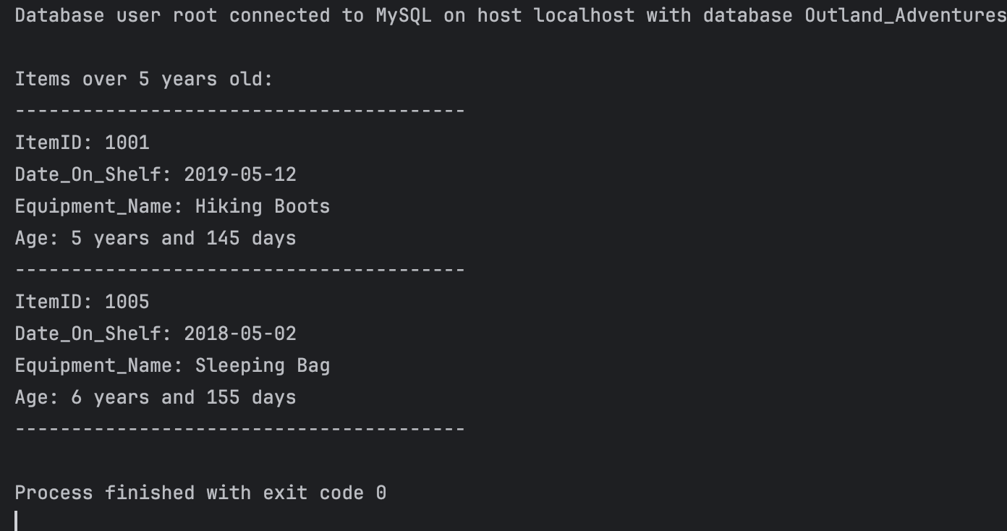
Script Output Image
Report 3

Slide 15
Report Three Assumptions
Assumptions:
The owners want to analyze the items stored over 5 years may no longer meet industry standards
The owners struggle with balancing costs of maintaining older inventory versus replacing it
The Business aims to prioritize safety and a positive customer experience
The owners believe inventory turnover is a key metric for the growth of the business
The data is stored in a privatized database

Slide 16
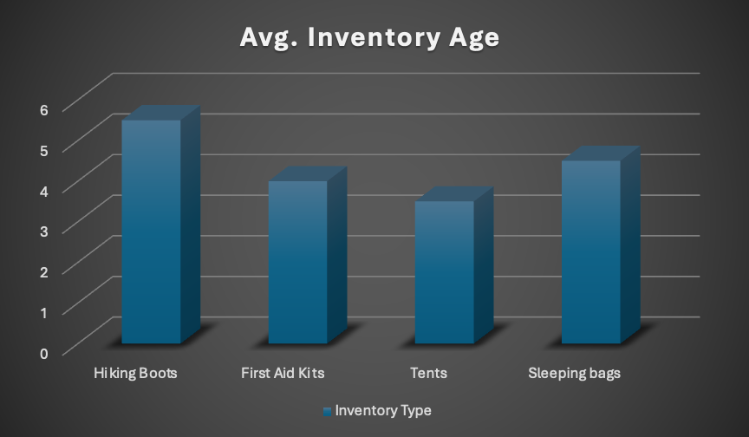
Report 3 Data Chart
The graph demonstrates the age of each inventory item in the facility. It will track and help with visualizing data.

